Slide 1
Chapter 9 One-Sample Hypothesis Tests
Copyright © 2022 McGraw Hill. All rights reserved. No reproduction or distribution without the prior written consent of McGraw Hill.
1-1

Slide 2
Chapter Learning Objectives
Chapter 9
LO9-1: Know the steps in testing hypotheses and define H₀ and H₁.
LO9-2: Define Type I error, Type II error, and power.
LO9-3: Formulate a null and alternative hypothesis for μ or π.
LO9-4: Explain decision rules, critical values, and rejection regions.
LO9-5: Perform a hypothesis test for a mean with known σ using z.
LO9-6: Use tables or Excel to find the p-value in tests of μ.
LO9-7: Perform a hypothesis test for a mean with unknown σ using t.
LO9-8: Perform a hypothesis test for a proportion and find the p-value.
LO9-9: Check whether normality may be assumed in testing a proportion.
LO9-10: Interpret a power curve or OC curve (optional).
LO9-11: Perform a hypothesis test for a variance (optional).

Slide 3
Hypothesis Testing
Chapter 9
Hypothesis testing is used in science and business to test assumptions and theories and guide managers when facing decisions.
We will first explain the logic behind hypothesis testing and then show how statistical hypothesis testing helps businesses make decisions.

Slide 4
Hypothesis Testing
LO 9-1
The business analyst asks questions, makes assumptions, and proposes testable theories about the values of key parameters of the business operating environment.
Each assumption is tested against observed data. If an assumption has not been disproved, in spite of rigorous efforts to do so, the business may operate under the belief that the statement is true.
The analyst states the assumption, called a hypothesis, in a format that can be tested using well-known statistical procedures.
The hypothesis is compared with sample data to determine if the data are consistent or inconsistent with the hypothesis.
When the data are found to be inconsistent (i.e., in conflict) with the hypothesis, the hypothesis is either discarded or reformulated.

Slide 5
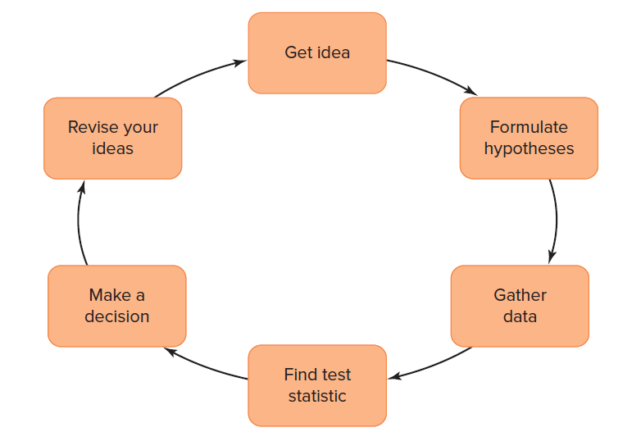
Hypothesis Testing as an Ongoing Process
LO 9-1

Slide 6
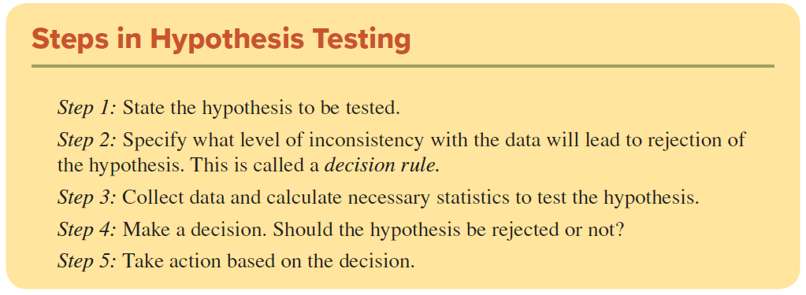
Hypothesis Testing
LO 9-1
All business managers need at least a basic understanding of hypothesis testing because managers often interact with specialists, read technical reports, and then make recommendations on key financial or strategic decisions based on statistical evidence.

Slide 7

Step 1: State the Hypothesis
LO 9-1
Formulate a pair of mutually exclusive, collectively exhaustive statements about the world. One statement or the other must be true, but they cannot both be true.
The two statements are hypotheses because the truth is unknown.
Efforts will be made to reject the null hypothesis.

Slide 8
Step 1: State the Hypothesis
LO 9-1
H₀ must be stated in a precise way so that it can be tested against empirical evidence from a sample.
If H₀ happens to be an established theory, we might not really expect to reject it, but we try anyway.
If we reject H₀, we tentatively conclude that the alternative hypothesis H₁ is the case.
H₀ represents the status quo (e.g., the current state of affairs), while H₁ is sometimes called the action alternative because action may be required if we reject H₀ in favor of H₁.

Slide 9
Examples
LO 9-1
Criminal Trial In a criminal trial, the hypotheses are
H₀: The defendant is innocent
H₁: The defendant is guilty
Our legal system assumes a defendant is innocent unless the evidence gathered by the prosecutor is sufficient to reject this assumption.
Drug Testing When an Olympic athlete is tested for performance-enhancing drugs (“doping”), the presumption is that the athlete is in compliance with the rules. The hypotheses are
H₀: No banned substance was used
H₁: Banned substance was used
Samples of urine or blood are taken as evidence and used only to disprove the null hypothesis because we assume the athlete is free of banned substances.

Slide 10
Step 2: Specify the Decision Rule
LO 9-1
Before collecting data to compare against the hypothesis, the researcher must specify how the evidence will be used to reach a decision about the null hypothesis.
For example, in our legal system, the evidence presented by the prosecutor must convince a jury “beyond a reasonable doubt” that the defendant is not innocent.

Slide 11
Steps 3 and 4: Data Collection and Decision Making
LO 9-1
Much of the critical work in hypothesis testing takes place during steps 1 and 2.
Once the hypotheses and decision rule have been clearly articulated, the process of data collection, while occasionally time-consuming, is straightforward.
We compare the data with the hypothesis, using the decision rule, and decide to reject or not reject the null hypothesis.

Slide 12
Step 5: Take Action Based on Decision
LO 9-1
This last step—taking action—requires experience and expertise on the part of the decision maker.
Suppose the evidence presented at a trial convinces a jury that the defendant is not innocent. What punishment should the judge impose?
Appropriate action for the decision should relate back to the purpose of conducting the hypothesis test in the first place.

Slide 13
Can a Null Hypothesis Be Proved?
LO 9-1
No, we cannot prove a null hypothesis—we can only fail to reject it.
A null hypothesis that survives repeated tests without rejection is “true” only in the limited sense that it has been thoroughly scrutinized and tested.
Today’s “true” hypothesis could be disproved tomorrow if new data are found.
If we fail to reject H₀, the same hypothesis may be retested. That is how scientific inquiry works.

Slide 14
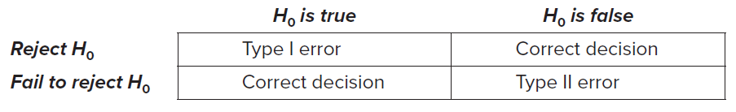
Type I and Type II Errors
LO 9-2
It is possible to make an incorrect decision regarding the null hypothesis.
As illustrated in the table below, either the null hypothesis is true or it is false.
We have two possible choices concerning the null hypothesis. We either reject H₀ or fail to reject H₀.
The true situation determines whether our decision was correct. If the decision about the null hypothesis matches the true situation, the decision was correct.

Slide 15
Type I and Type II Errors
LO 9-2
Rejecting the null hypothesis when it is true is a Type I error (also called a false positive).
Failure to reject the null hypothesis when it is false is a Type II error (also called a false negative).
In either case, an incorrect decision was made.
We can minimize the chance of error by collecting as much sample evidence as our resources allow and by choosing proper testing procedures.

Slide 16
Consequences of Type I and Type II Errors
LO 9-2
The consequences of these two errors are quite different, and the costs are borne by different parties.
Example: Type I error is convicting an innocent defendant, so the costs are borne by the defendant. Type II error is failing to convict a guilty defendant, so the costs are borne by society if the guilty person returns to the streets.
Firms are increasingly wary of Type II error (failing to recall a product as soon as sample evidence begins to indicate potential problems).

Slide 17
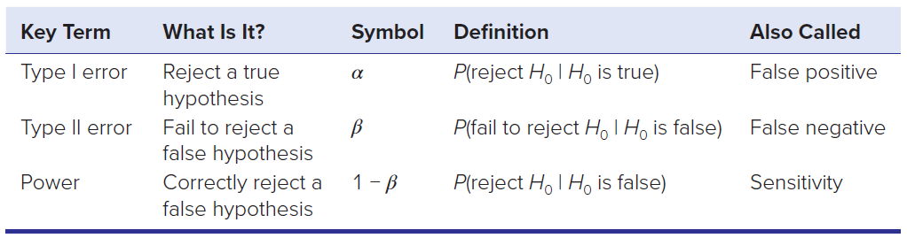
Probability of Type I and Type II Errors
LO 9-2
The probability of a Type I error (rejecting a true null hypothesis) is denoted α (the lowercase Greek letter “alpha”).
Statisticians refer to α as the level of significance.
The probability of a Type II error (not rejecting a false hypothesis) is denoted β (the lowercase Greek letter “beta”)

Slide 18
Power
LO 9-2
The power of a test is the probability that a false hypothesis will be rejected (as it should be).
Power equals 1 − β and is the complement of Type II error.
Reducing β would correspondingly increase power (usually accomplished by increasing the sample size).
Larger samples lead to increased power, which is why clinical trials often involve thousands of people.

Slide 19
Relationship Between α and β
LO 9-2
Both a small α and a small β are desirable.
For a given type of test and fixed sample size, there is a trade-off between α and β.
The larger critical value needed to reduce α risk makes it harder to reject H₀, thereby increasing β risk.
Both α and β can be reduced simultaneously only by increasing the sample size.

Slide 20
How are α and β Calculated
LO 9-2
The level of significance, α, is not calculated using a formula. Instead, we choose a value based on our willingness to risk making a Type I error.
Typical values are .01, .05, or .10.
Choosing a smaller value of α reflects a greater concern with the consequences of a Type I error.
The value of β, and consequently power (1 − β), will vary depending on the difference between the true mean μ and the hypothesized mean μ₀, the standard deviation σ, the sample size n, and the level of significance α.

Slide 21
Decision Rules and Critical Values
LO 9-3
A statistical hypothesis is a statement about the value of a population parameter that we are interested in. For example, the parameter could be a mean, a proportion, or a variance.
A hypothesis test is a decision between two competing, mutually exclusive, and collectively exhaustive hypotheses about the value of the parameter.

Slide 22
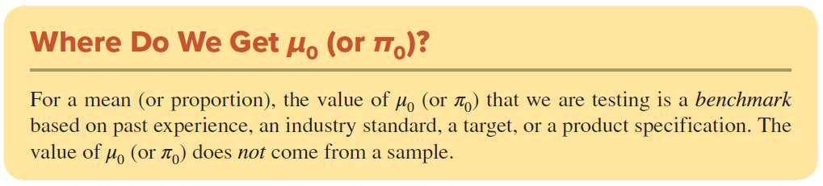
Decision Rules and Critical Values
LO 9-3
The null hypothesis states a benchmark value that we denote with the subscript “0,” as in μ₀ or π₀.
The hypothesized value μ₀ or π₀ does not come from a sample but is based on past performance, an industry standard, a target, or a product specification.

Slide 23
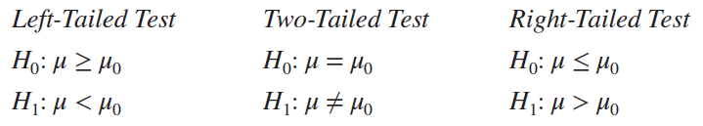
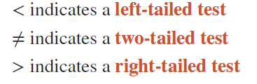
One-Tailed and Two-Tailed Tests
LO 9-3
For a mean, the null hypothesis H₀ states the value(s) of μ₀ that we will try to reject. There are three possible alternative hypotheses:
The application will dictate which of the three alternatives is appropriate. The direction of the test is indicated by which way the inequality symbol points in H₁:

Slide 24
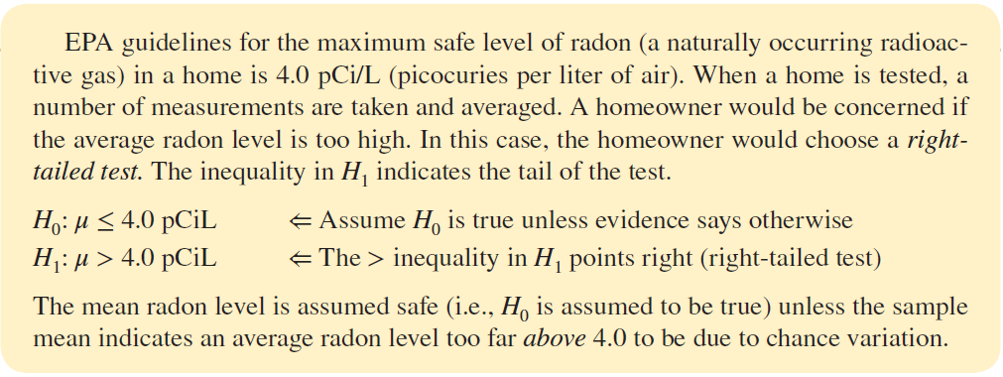
Example
LO 9-3

Slide 25
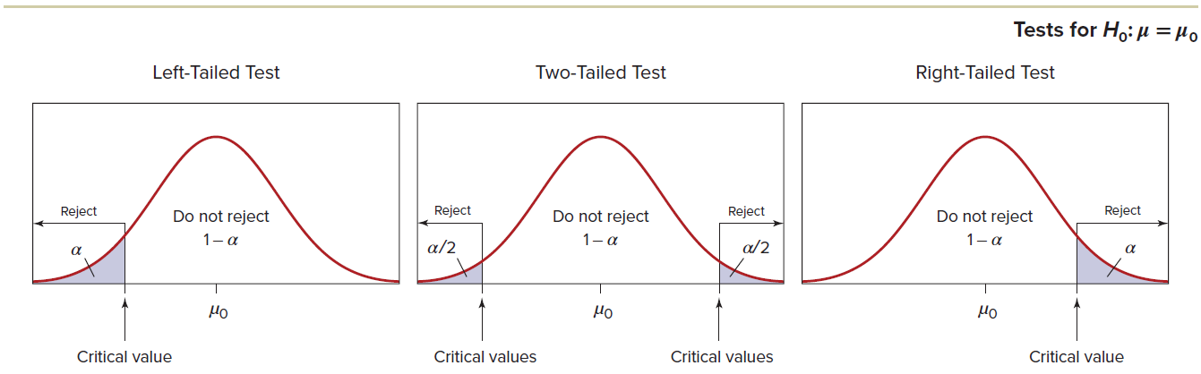
Decision Rule
LO 9-4
We specify our decision rule by defining an “extreme” outcome.
The area under the sampling distribution curve that defines an extreme outcome is called the rejection region.
You may visualize the level of significance (α) as an area in the tail(s) of a distribution (e.g., normal) far enough from the center that it represents an unlikely outcome if our null hypothesis is true.

Slide 26
Decision Rule
LO 9-4
We will calculate a test statistic that measures the difference between the sample statistic and the hypothesized parameter.
A test statistic that falls in the shaded region will cause rejection of H₀.
The area of the nonrejection region (white area) is 1 − α.

Slide 27
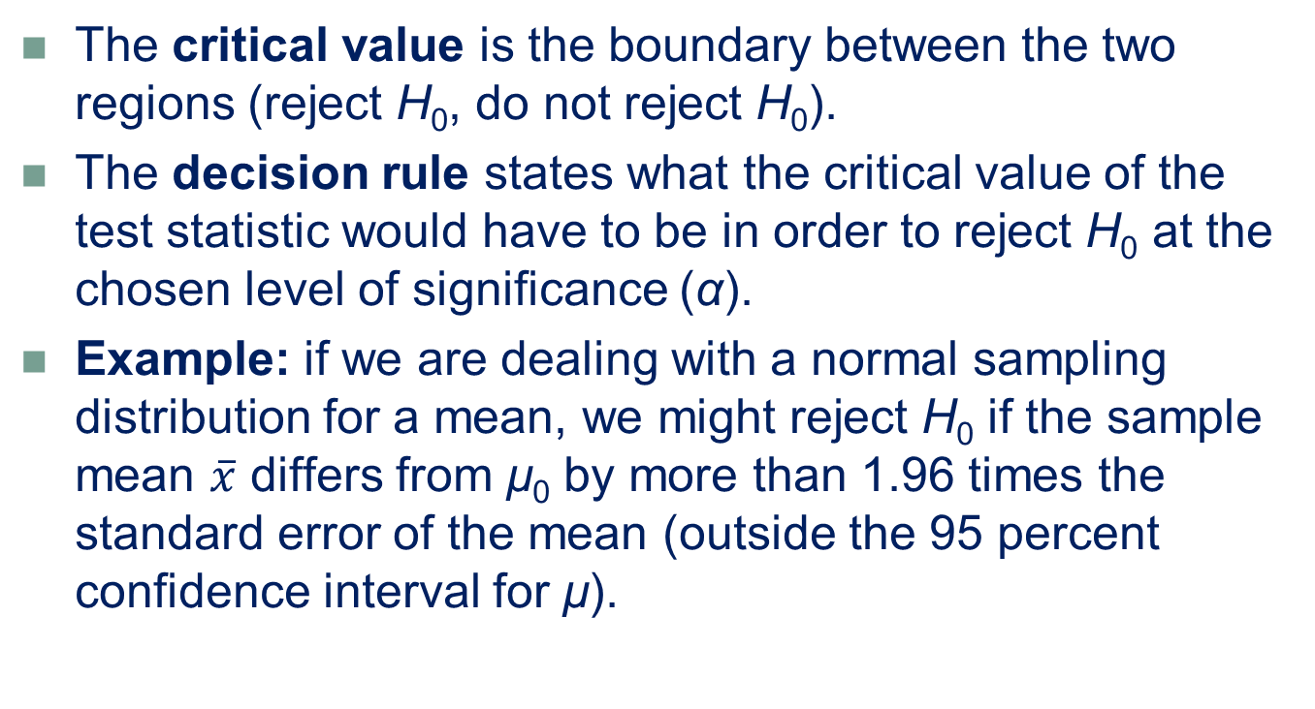
Critical Value
LO 9-4
The critical value is the boundary between the two regions (reject H₀, do not reject H₀).
The decision rule states what the critical value of the test statistic would have to be in order to reject H₀ at the chosen level of significance (α).
Example: if we are dealing with a normal sampling distribution for a mean, we might reject H₀ if the sample mean $\overline{x}$ differs from μ₀ by more than 1.96 times the standard error of the mean (outside the 95 percent confidence interval for μ).

Slide 28
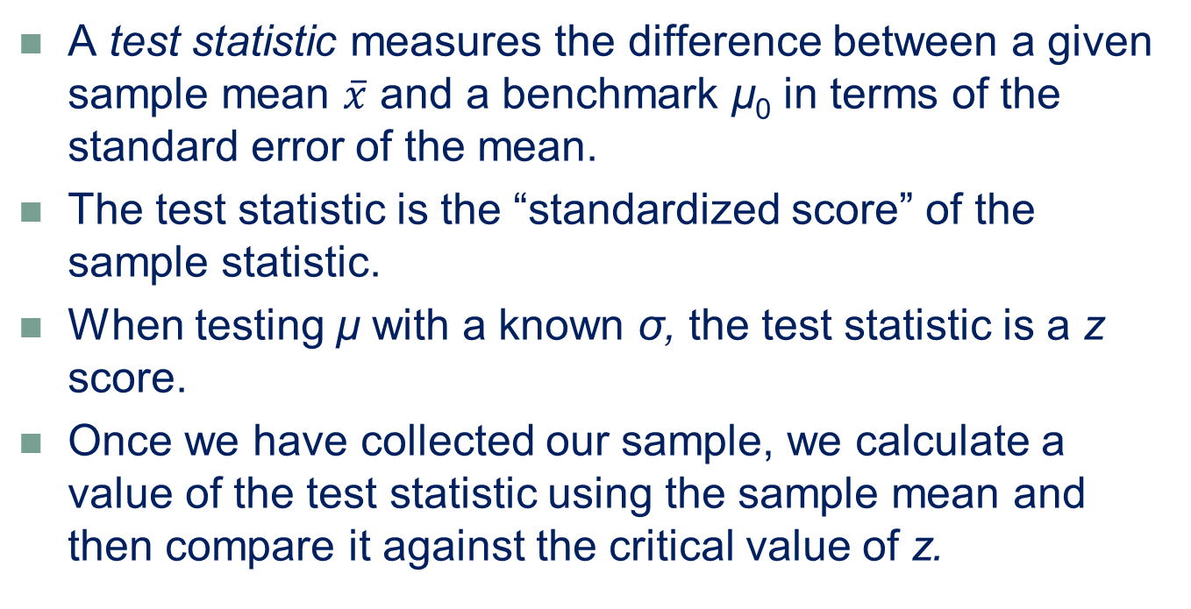
Testing A Mean: Known Population Variance
LO 9-5
A test statistic measures the difference between a given sample mean $\overline{x}$ and a benchmark μ₀ in terms of the standard error of the mean.
The test statistic is the “standardized score” of the sample statistic.
When testing μ with a known σ, the test statistic is a z score.
Once we have collected our sample, we calculate a value of the test statistic using the sample mean and then compare it against the critical value of z.

Slide 29
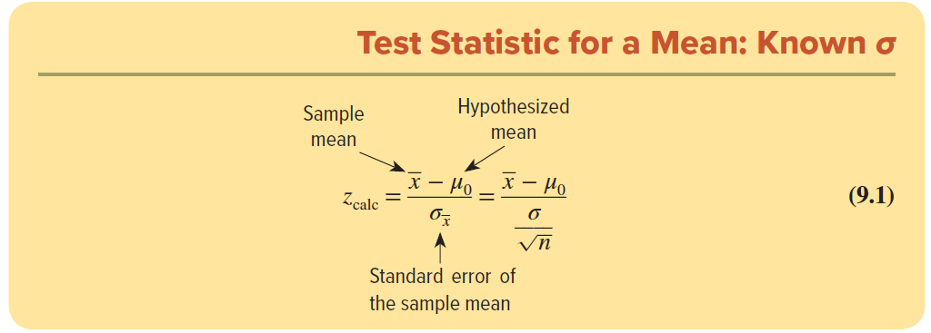

Test Statistic
LO 9-5
If the true mean of the population is μ₀, then the value of a particular sample mean $\overline{x}$ calculated from our sample should be near μ₀, and therefore the test statistic should be near zero.

Slide 30
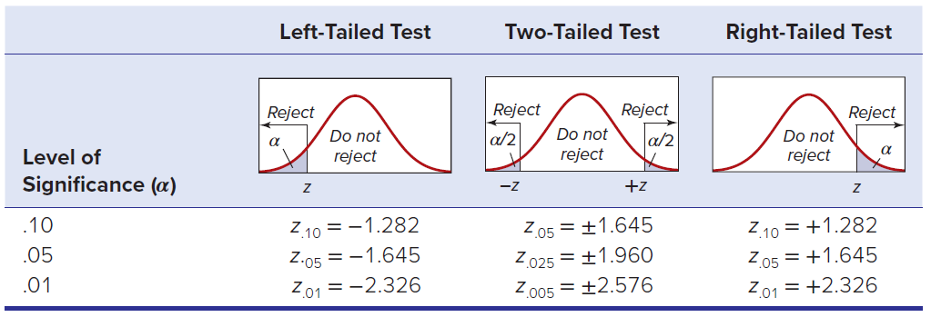
Critical Value
LO 9-5
The test statistic is compared with a critical value from a table.
The critical value is the boundary between two regions (reject H₀, do not reject H₀) in the decision rule.
The critical value shows the range of values for the test statistic that would be expected by chance if the null hypothesis were true.

Slide 31
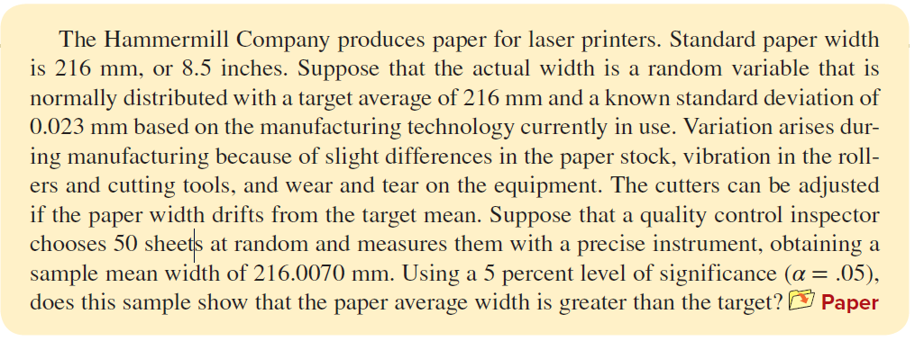
Example: Paper Manufacturing
LO 9-5

Slide 32

Example: Paper Manufacturing
LO 9-5
Step 1: State the Hypothesis
The question indicates a right-tailed test, so the hypotheses would be
From the null hypothesis, we see that μ0 = 216 mm, which is the target width.

Slide 33

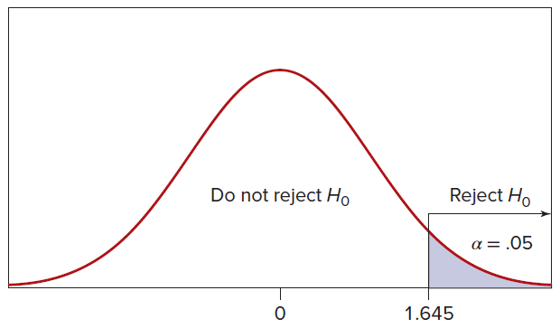
Example: Paper Manufacturing
LO 9-5
Step 2: Specify the Decision Rule
We use the level of significance to find the critical value of the z statistic that determines the threshold for rejecting the null hypothesis to be α = .05.
The critical value of z that accomplishes this is z_{.05} = 1.645.
The decision rule is

Slide 34
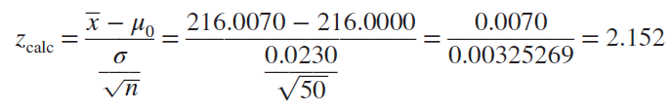

Example: Paper Manufacturing
LO 9-5
Step 3: Collect Sample Data and Calculate the Test Statistic
If H₀ is true, then the test statistic should be near 0 because $\overline{x}$ should be near μ₀. The value of the test statistic is

Slide 35
Example: Paper Manufacturing
LO 9-5
Step 4: Make the Decision
The test statistic falls in the right rejection region, so we reject the null hypothesis H₀: μ ≤ 216 and conclude the alternative hypothesis H₁: μ > 216 at the 5 percent level of significance.
Although the difference is slight, it is statistically significant.
Test Statistic: z = 2.152
Reject H₀

Slide 36
Example: Paper Manufacturing
LO 9-5
Step 5: Take Action
Now that we have concluded that the process is producing paper with an average width greater than the target, it is time to adjust the manufacturing process to bring the average width back to target.
Our course of action could be to readjust the machine settings, or it could be time to resharpen the cutting tools.
At this point it is the responsibility of the process engineers to determine the best course of action.

Slide 37
p-Value Method
LO 9-6
The p-value method is a more flexible approach that is often preferred by statisticians over the critical value method.
It requires that you express the strength of your evidence (i.e., your sample) against the null hypothesis in terms of a probability.
The p-value answers the following question: If the null hypothesis is true, what is the probability that we would observe our particular sample mean (or one even farther away from _{μ0)}?
The p-value gives us more information than a test using one particular value of α because the observer can choose any α that is appropriate for the problem.
Whether we use the critical value approach or the p-value approach, our decision about the null hypothesis will be the same.

Slide 38
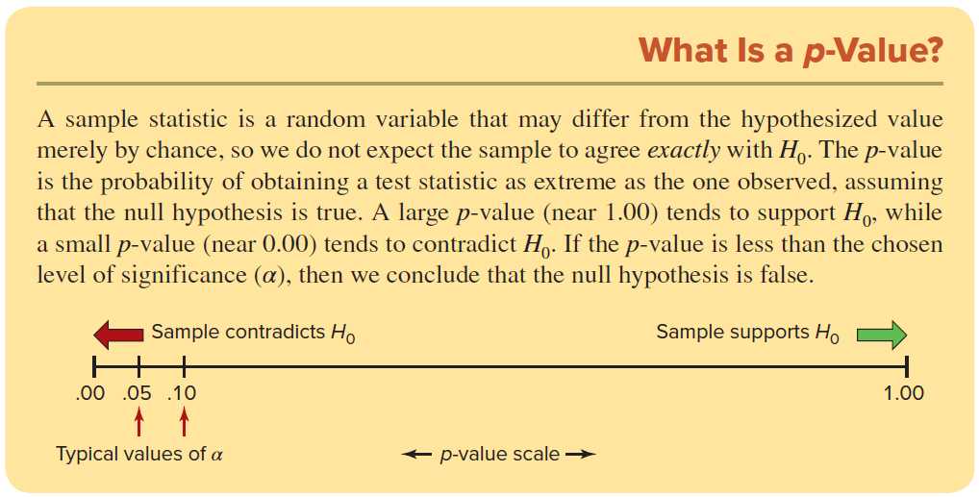
p-Value Method
LO 9-6

Slide 39

Example: Paper Manufacturing
LO 9-6
In this case, the manufacturer decided that a two-tailed test would be more appropriate because the objective is to detect a deviation from the desired mean in either direction.
Step 1: State the Hypotheses:
For a two-tailed test, the hypotheses are

Slide 40
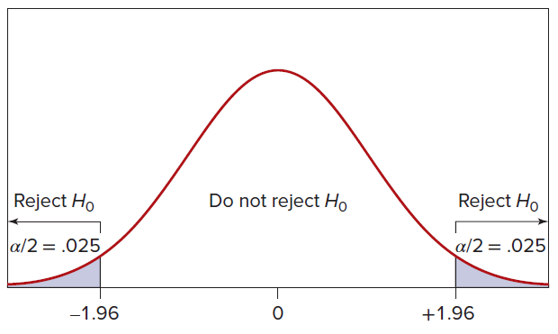
Example: Paper Manufacturing
LO 9-6
Step 2: Specify the Decision Rule
We will use the same α = .05 as in the right-tailed test.
But for a two-tailed test, we split the risk of Type I error by putting α/2 = .05/2 = .025 in each tail.
For α = .05 in a two-tailed test, the critical value is z_{.025} = ±1.96, so the decision rule is:
Reject H0 if zcalc > +1.96
or if zcalc < −1.96
Otherwise, do not reject H0

Slide 41
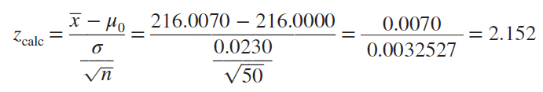
Example: Paper Manufacturing
LO 9-6
Step 3: Calculate the Test Statistic
The test statistic is unaffected by the hypotheses or the level of significance.
The value of the test statistic is the same as for the one-tailed test:

Slide 42
Example: Paper Manufacturing
LO 9-6
Step 4: Make the Decision
Because the test statistic falls in the right tail of the rejection region, we reject the null hypothesis H₀: μ = 216 and conclude H₁: μ ≠ 216 at the 5 percent level of significance. Another way to say this is that the sample mean differs significantly from the desired target width at α = .05 in a two-tailed test.
Step 5: Take Action
An adjustment is needed, such as changing the cutting tool settings. Now it is up to the process engineers to choose the best course of action.
Test Statistic: z = 2.152
Reject H₀

Slide 43
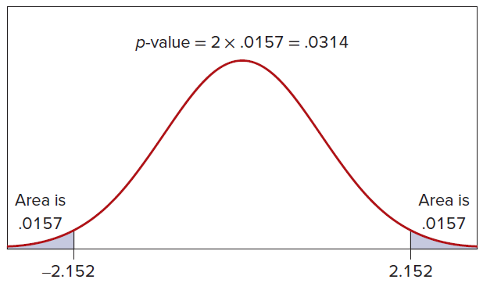
Example: Paper Manufacturing
LO 9-6
p-Value Approach
The p-value in this two-tailed test is 2 × P(zcalc > 2.152) = 2 × .0157 = .0314.
This says that in a two-tailed test, a result as extreme as 2.152 would arise about 3.14 percent of the time by chance alone if the null hypothesis were true.

Slide 44

Analogy to Confidence Intervals
LO 9-6
A two-tailed hypothesis test at the 5 percent level of significance (α = .05) is equivalent to asking whether the 95 percent confidence interval for the mean includes the hypothesized mean.
If the confidence interval includes the hypothesized mean H₀: μ = 216, then we cannot reject the null hypothesis.
In this case, the 95 percent confidence interval would be
Because this confidence interval does not include 216, we reject the null hypothesis H₀: μ = 216.

Slide 45
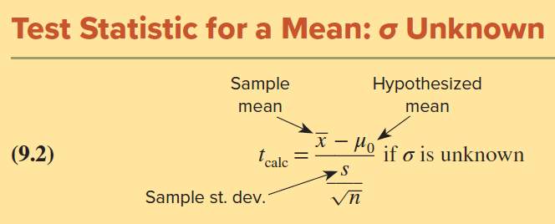
Testing a Mean: Unknown Population Variance
LO 9-7
If the population variance σ² must be estimated from the sample, the hypothesis testing procedure is modified.
The basic hypothesis testing steps are the same.
When the population standard deviation σ is unknown and the population may be assumed normal, the test statistic follows the Student’s t distribution with n − 1 degrees of freedom.
Because σ is rarely known, we generally expect to use Student’s t instead of z.

Slide 46
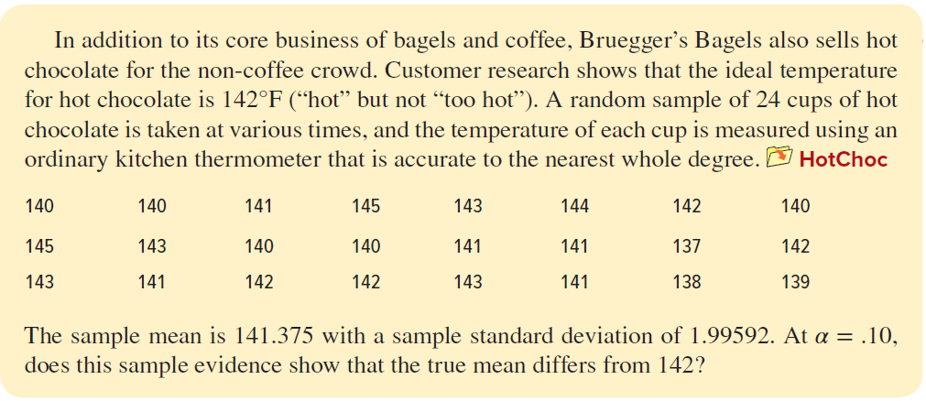
Example: Hot Chocolate
LO 9-7

Slide 47

Example: Hot Chocolate
LO 9-7
Step 1: State the Hypotheses
We use a two-tailed test. The null hypothesis is in conformance with the desired standard.
Step 2: Specify the Decision Rule
For α = .10, using the Excel function =T.INV.2T(α, d.f.) =T.INV.2T(0.10,23) = 1.714 gives the two-tailed critical value for d.f. = n − 1 = 24 − 1 = 23 degrees of freedom.
We will reject H₀ if t_{calc} > 1.714 or if t_{calc} < −1.714

Slide 48
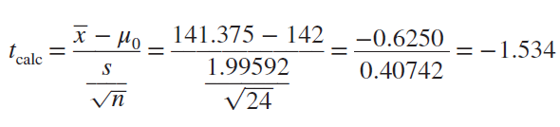
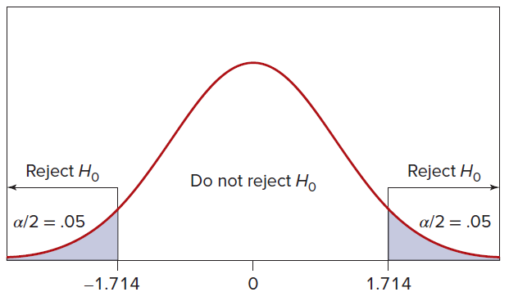
Example: Hot Chocolate
LO 9-7
Step 3: Calculate the Test Statistic
Step 4: Make the Decision
Because the test statistic lies within the range of chance variation, we cannot reject the null hypothesis H₀: μ = 142.
The Test Statistic is not in the critical region
Fail to Reject H₀

Slide 49
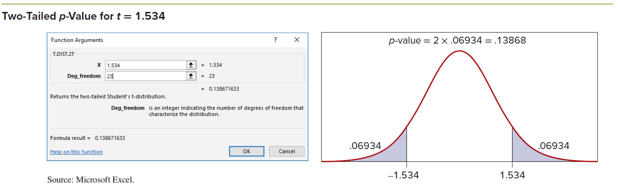
Example: Hot Chocolate
LO 9-7
Using the p-Value
We want to determine the tail area less than t = −1.534 or greater than t = +1.534.
It is easier and more precise to use Excel’s function T.DIST.2T(1.534,23) to get the two-tailed p-value of .13867. The area of each tail is half that, or .06934

Slide 50
Example: Hot Chocolate
LO 9-7
Step 5: Take Action
It is doubtful whether a consumer could tell the difference in hot chocolate temperature within a few degrees of 142°F, so a tiny difference in means might lack practical importance even if it were statistically significant.
Importance must be judged by management, not by the statistician.

Slide 51

Confidence Interval vs Hypothesis Test
LO 9-7
The two-tailed test at the 10 percent level of significance is equivalent to a two-tailed 90 percent confidence interval.
If the confidence interval does not contain μ₀, we reject H₀.
For the hot chocolate, the sample mean is 141.375 with a sample standard deviation of 1.99592. Using Appendix D we find t_{.05} = 1.714, so the 90 percent confidence interval for μ is
Because μ = 142 lies within the 90 percent confidence interval [140.677, 142.073], we cannot reject the hypothesis H₀: μ = 142 at α = .10 in a two-tailed test.

Slide 52
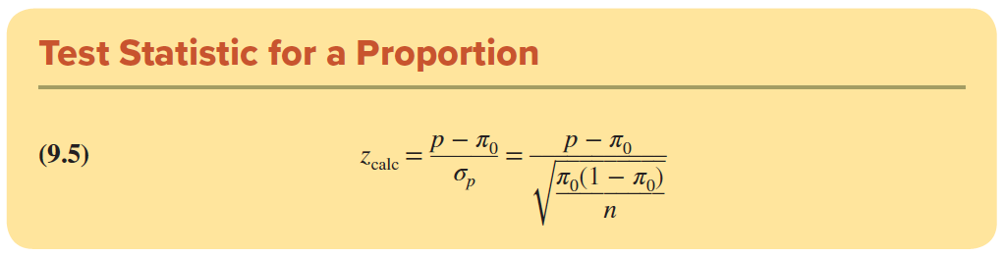
Testing a Proportion
LO 9-8
The steps we follow for testing a hypothesis about a population proportion, π, are the same as the ones we follow for testing a mean.
The difference is that we now calculate a sample proportion, p, to calculate the test statistic.
The test statistic, calculated from sample data, is the difference between the sample proportion p and the hypothesized proportion π₀ divided by the standard error of the proportion (sometimes denoted σ_{p}):

Slide 53
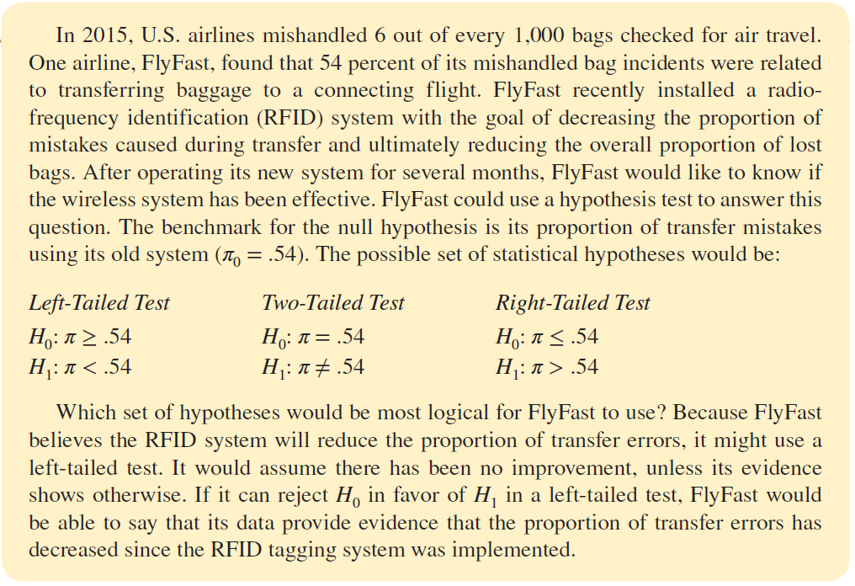
Testing a Proporotion
LO 9-8

Slide 54
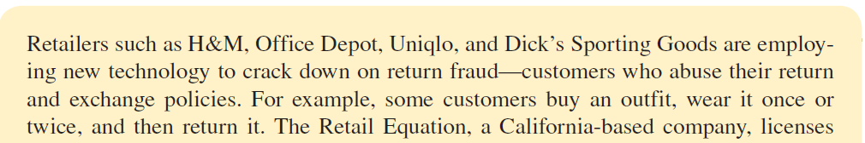
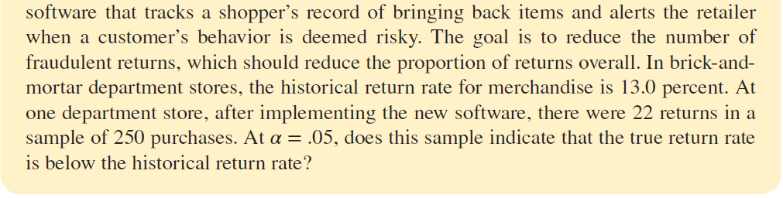
Example: Return Policy
LO 9-8

Slide 55

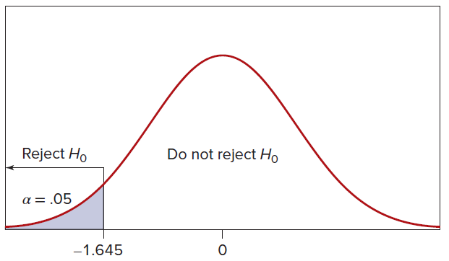
Example: Return Policy
LO 9-8
Step 1: State the Hypotheses:
Step 2: Specify the Decision Rule
For α = .05 in a left-tailed test, the critical value is z_{.05} = −1.645, so the decision rule is

Slide 56
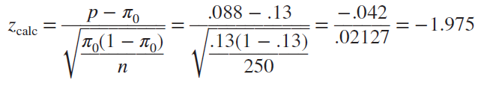
Example: Return Policy
LO 9-8
Step 3: Calculate the Test Statistic
Because p = x/n = 22/250 = .088, the sample seems to favor H1. But we will assume that H0 is true and see if the test statistic contradicts this assumption. We test the hypothesis at π = .13. If we can reject π = .13 in favor of π < .13, then we implicitly reject the class of hypotheses π ≥ .13. The test statistic is the difference between the sample proportion p = x/n and the hypothesized parameter π₀ divided by the standard error of p:

Slide 57
Example: Return Policy
LO 9-8
Step 4: Make the Decision
Because the test statistic falls in the left-tail rejection region, we reject H₀. We conclude that the return rate is less than .13 after implementing the new software.
Step 5: Take Action
The rate of returns seems to be reduced, so the store might want to try using the software at its other locations.
Test Statistic: z = -1.975
Reject H₀

Slide 58
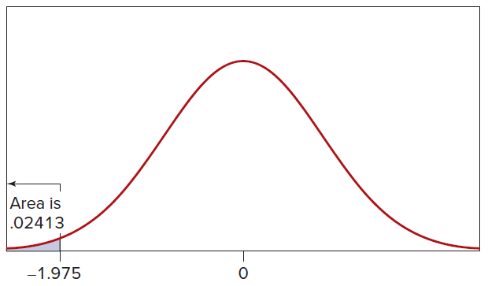
Example: Return Policy
LO 9-8
Using the p-Value
For our test statistic z_{calc} = −1.975, the p-value (.02413) can be obtained from Excel’s cumulative standard normal =NORM.S.DIST(−1.975).
Using the p-value, we reject H₀ at α = .05, but the decision would be very close if we had used α = .025.

Slide 59
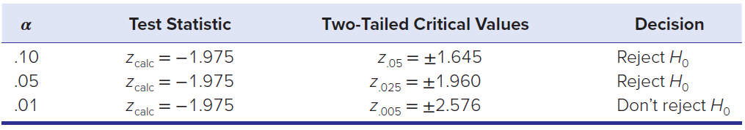
The effect of α
LO 9-8
Would the decision be the same if we had used a different level of significance? While the test statistic z_{calc} = −1.975 is the same regardless of our choice of α, our choice of α does affect the decision.

Slide 60
Small Samples and Non-Normality
LO 9-9
Our rule is to assume normality if nπ₀ ≥ 10 and n(1 − π₀) ≥ 10. When this is satisfied, the test statistic will be a z-score.
When this is not satisfied, we will have to use the exact binomial test. We can use Excel to perform the exact binomial test.

Slide 61
Power Curves
LO 9-10
Recall that power is the probability of correctly rejecting a false null hypothesis. While we cannot always attain the power we desire in a statistical test, we can at least calculate what the power would be in various possible situations.
Power depends on how far the true value of the parameter is from the null hypothesis value.
The further away the true population value is from the assumed value, the easier it is for your hypothesis test to detect and the more power it has.

Slide 62

Example: PVC Pipe
LO 9-10
Consider a utility that is installing underground PVC pipe as a cable conduit. The specifications call for a mean strength of 12,000 psi (pounds per square inch). A sample of 25 pieces of pipe is tested under laboratory conditions to ascertain the compressive pressure that causes the pipe to collapse. The standard deviation is known from past experience to be σ = 500 psi. If the pipe proves stronger than the specification, there is no problem, so the utility requires a left-tailed test:

Slide 63

Example: PVC Pipe
LO 9-10
If the true mean strength is 11,900 psi, what is the probability that the utility will fail to reject the null hypothesis and mistakenly conclude that μ = 12,000? At α = .05, what is the power of the test?
Recall that β is the risk of Type II error, the probability of incorrectly accepting a false hypothesis. Type II error is bad, so we want β to be small.
In this example, β = P(conclude μ = 12,000 | μ = 11,900).
Conversely, power is the probability that we correctly reject a false hypothesis. More power is better, so we want power to be as close to 1 as possible:

Slide 64
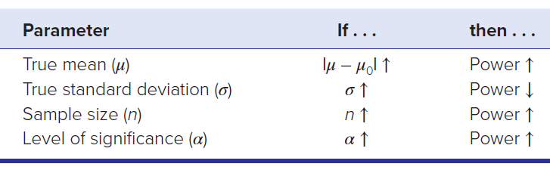
Example: PVC Pipe
LO 9-10
The values of β and power will vary, depending on the difference between the true mean μ and the hypothesized mean μ₀, the standard deviation σ, the sample size n, and the level of significance α.
While we cannot change μ and σ, the sample size and level of significance often are under our control. We can get more power by increasing α, but would we really want to increase Type I error in order to reduce Type II error? Probably not, so the way we usually increase power is by choosing a larger sample size.

Slide 65


Example: PVC Pipe
LO 9-10
Step 1:
Find the left-tail critical value for the sample mean. At α = .05 in a left-tailed test, we know that z_{.05} = −1.645. Using the formula for a z-score
In terms of the data units of measurement (pounds per square inch), the decision rule is

Slide 66
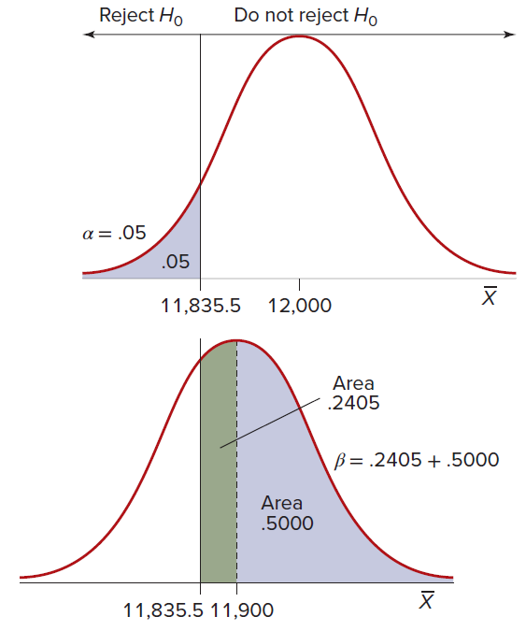
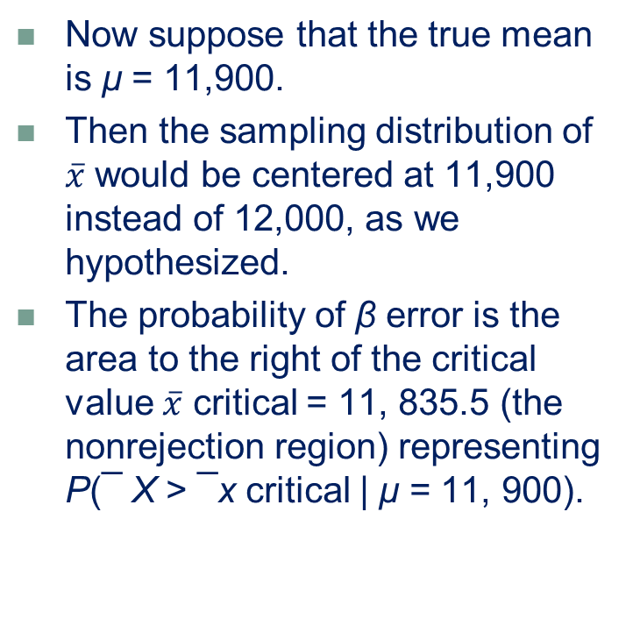
Example: PVC Pipe
LO 9-10
Now suppose that the true mean is μ = 11,900.
Then the sampling distribution of $\overline{x}$ would be centered at 11,900 instead of 12,000, as we hypothesized.
The probability of β error is the area to the right of the critical value $\overline{x}$ critical = 11, 835.5 (the nonrejection region) representing P(¯ X > ¯x critical | μ = 11, 900).

Slide 67
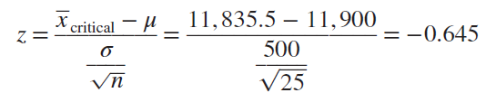
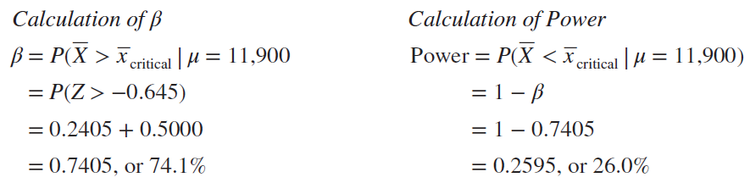
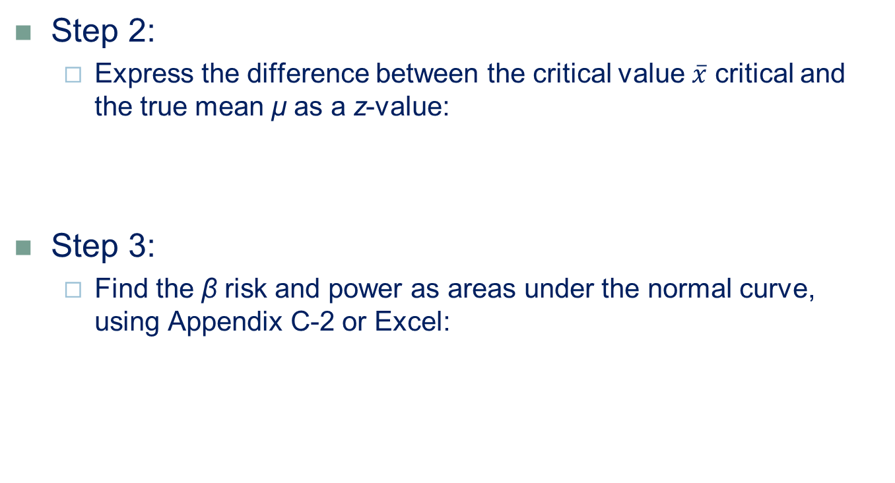
Example: PVC Pipe
LO 9-10
Step 2:
Express the difference between the critical value $\overline{x}$ critical and the true mean μ as a z-value:
Step 3:
Find the β risk and power as areas under the normal curve, using Appendix C-2 or Excel:

Slide 68
Example: PVC Pipe
LO 9-10
This calculation shows that if the true mean is μ = 11,900, then there is a 74.05 percent chance that we will commit β error by failing to reject μ = 12,000.
Because 11,900 is not very far from 12,000 in terms of the standard error, our test has relatively low power.
Although our test may not be sensitive enough to reject the null hypothesis reliably if μ is only slightly less than 12,000, if μ is far below 12,000, our test would be more likely to lead to rejection of H₀.
Although we cannot know the true mean, we can repeat our power calculation for as many values of μ and n as we wish.

Slide 69
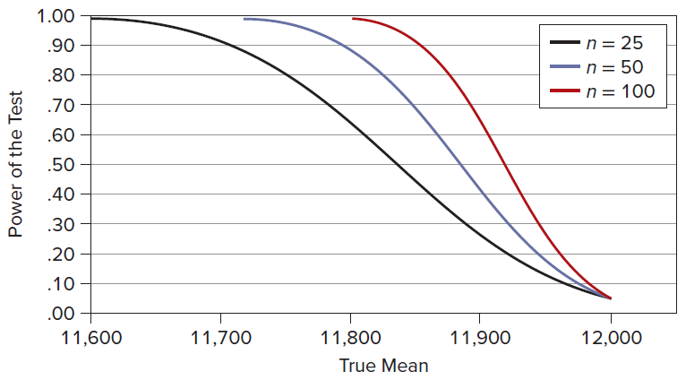
Relationship of the Power and OC Curves
LO 9-10
A power curve is a graph whose Y-axis shows the power of the test (1 − β) and whose X-axis shows the various possible true values of the parameter while holding the sample size constant.
Power increases as the departure of μ from 12,000 becomes greater.
Larger sample size creates a higher power curve.

Slide 70
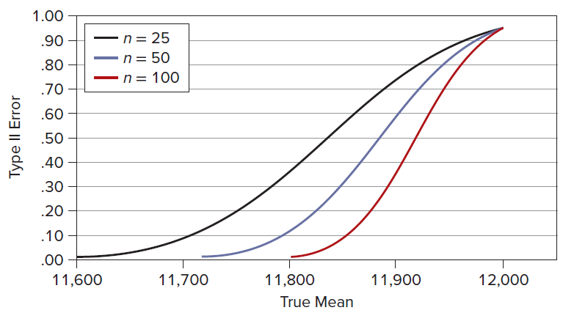
Relationship of the Power and OC Curves
LO 9-10
The graph of β risk against this same X-axis is called the operating characteristic or OC curve.
It is simply the converse of the power curve, so it is redundant if you already have the power curve.

Slide 71
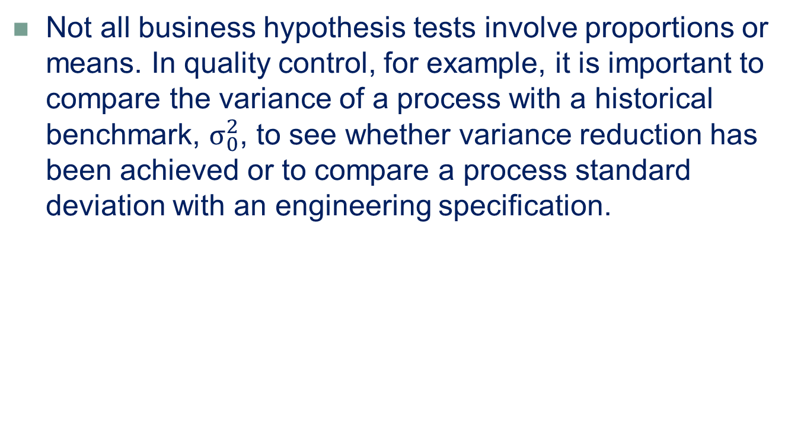
Tests for One Variance
LO 9-11
Not all business hypothesis tests involve proportions or means. In quality control, for example, it is important to compare the variance of a process with a historical benchmark, $σ_{0}^{2}$, to see whether variance reduction has been achieved or to compare a process standard deviation with an engineering specification.

Slide 72
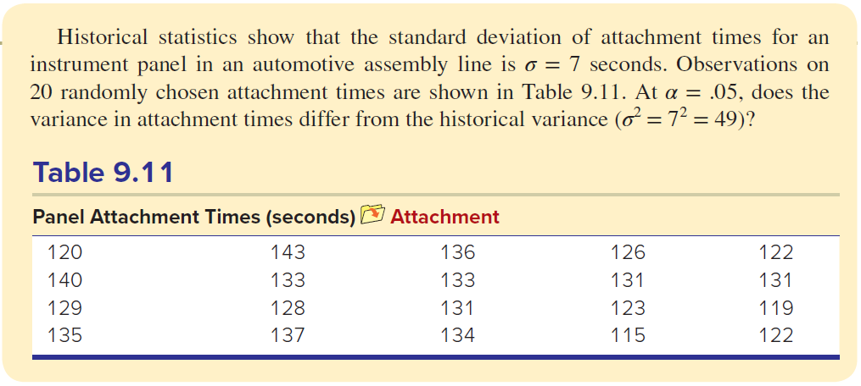
Example: Attachment Times
LO 9-11

Slide 73


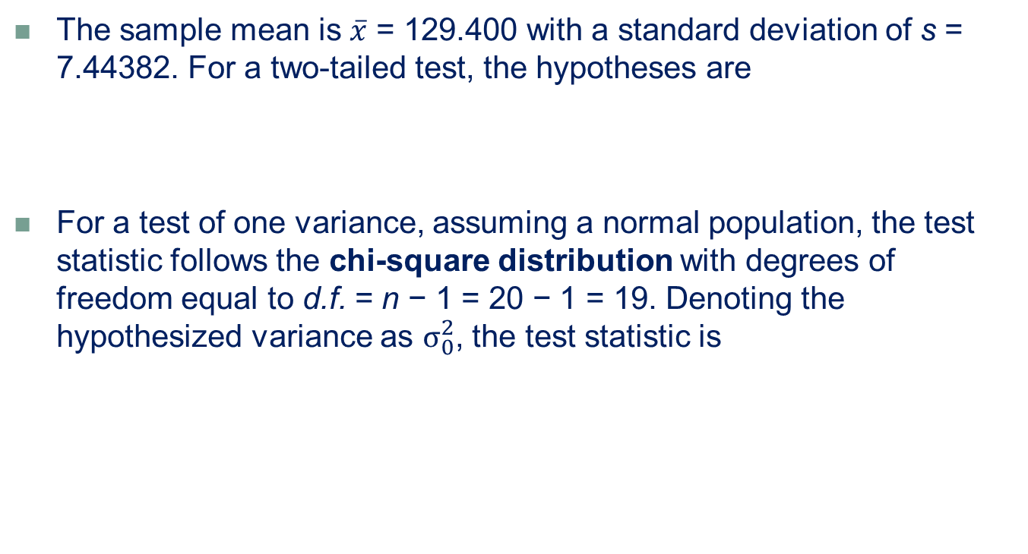
Example: Attachment Times
LO 9-11
The sample mean is $\overline{x}$ = 129.400 with a standard deviation of s = 7.44382. For a two-tailed test, the hypotheses are
For a test of one variance, assuming a normal population, the test statistic follows the chi-square distribution with degrees of freedom equal to d.f. = n − 1 = 20 − 1 = 19. Denoting the hypothesized variance as $σ_{0}^{2}$, the test statistic is

Slide 74



Example: Attachment Times
LO 9-11
For a two-tailed test, the decision rule based on the upper and lower critical values of chi-square is
We can use the Excel function =CHISQ.INV to get the critical values:
The value of the test statistic is

Slide 75
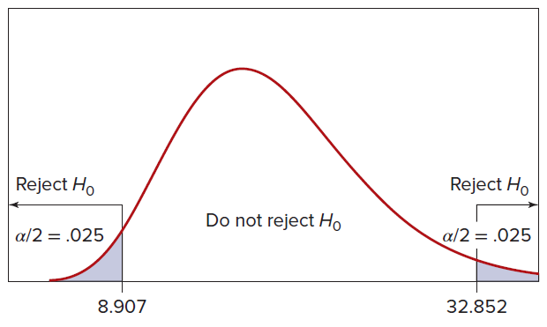
Example: Attachment Times
LO 9-11
Because the test statistic is within the middle range, we conclude that the population variance does not differ significantly from 49; that is, the assembly process variance is unchanged.

Slide 76
When to Use Tests for One Variance
LO 9-11
In general, we would be interested in a test of variances when it is not the center of the distribution, but rather the variability of the process, that matters.
More variation implies a more erratic data-generating process.
For example, variance tests are important in manufacturing processes because increased variation around the mean can be a sign of wear and tear on equipment or other problems that would require attention.

Slide 77
Chapter 9 Practice Problems

Slide 78
Question 3
LO 9-2
A firm decides to test its employees for illegal drugs.
a. State the null and alternative hypotheses.
b. Define Type I and II errors.
c. What are the consequences of each type of error, and to whom?

Slide 79
Question 10
LO 9-3
The average age of a part-time seasonal employee at a Vail Resorts ski mountain has historically been 37 years. State the hypotheses one would use to test whether this average has decreased since the last season.

Slide 80
Question 17
LO 9-3, 4, 5, 6
GreenBeam Ltd. claims that its compact fluorescent bulbs average no more than 3.50 mg of mercury. A sample of 25 bulbs shows a mean of 3.59 mg of mercury.
a. Write the hypotheses for a right-tailed test, using GreenBeam’s claim as the null hypothesis about the mean.
b. Assuming a known standard deviation of 0.18 mg, calculate the z test statistic to test the manufacturer’s claim.
c. At the 1 percent level of significance (α = .01), does the sample exceed the manufacturer’s claim?
d. Find the p-value.

Slide 81
Question 38
LO 9-7
The average weight of a package of rolled oats is supposed to be at least 18 ounces. A sample of 18 packages shows a mean of 17.78 ounces with a standard deviation of 0.41 ounce.
a. At the 5 percent level of significance, is the true mean smaller than the specification? Clearly state your hypotheses and decision rule.
b. Is this conclusion sensitive to the choice of α?
c. Use Excel to find the p-value. Interpret it.

Slide 82
Question 49
LO 9-8
In a hospital’s shipment of 3,500 insulin syringes, 14 were unusable due to defects.
a. At α = .05, is this sufficient evidence to reject future shipments from this supplier if the hospital’s quality standard requires 99.7 percent of the syringes to be acceptable? State the hypotheses and decision rule.
b. May normality of the sample proportion p be assumed?
c. Explain the effects of Type I error and Type II error.
d. Find the p-value.

Slide 83
Question 56
LO 9-9
Perfect pitch is the ability to identify musical notes correctly without hearing another note as a reference. The probability that a randomly chosen person has perfect pitch is .0005.
a. If 20 students at Julliard School of Music are tested and 2 are found to have perfect pitch, would you conclude at the .01 level of significance that Julliard students are more likely than the general population to have perfect pitch? Hint: Use Excel to find the right-tailed binomial probability P(X ≥ 2 | n = 20, π = .0005).
b. Show that normality of the sample proportion p should not be assumed.

Slide 84
Question 59
LO 9-10
For a certain wine, the mean pH (a measure of acidity) is supposed to be 3.50 with a known standard deviation of σ = .10. The quality inspector examines 25 bottles at random to test whether the pH is too low, using a left-tailed test at α = .01.
a. What is the power of this test if the true mean is μ = 3.48?
b. If the true mean is μ = 3.46?
c. If the true mean is μ = 3.44?

Slide 85
Question 65
LO 9-11
In U.S. hospitals, the average length of stay (LOS) for a diagnosis of pneumonia is 137 hours with a standard deviation of 25 hours. The LOS (in hours) for a sample of 12 pneumonia patients at Santa Theresa Memorial Hospital is shown below. In a two-tailed test at α = .05, is this sample variance consistent with the national norms? Show all steps, including the hypotheses and critical values from Appendix E.
132 | 143 | 143 | 120 | 124 | 116
130 | 165 | 100 | 83 | 115 | 141

Slide 86
Chapter 9 Analytics in Action

Slide 87
